Slide 1
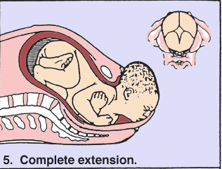
MECHANISM OF LABOUR
Dr Shanthi Serene Sylum V MD(Hom)
Professor & HOD
Dept: Obstetrics & Gynaecology

Slide 2
It means the manner by which the fetous adjusts itself to , and passes through the parturiant canal with the minimum amount of difficulty.

Slide 3
Definition
It is the series of movements adopted by foetus in its birth passage during expulsion in normal labour.
Presentation in normal labour :-
VERTEX
LOA ROA

Slide 4
Steps of the cardinal movements are-
Engagement
Desent occurs in first
Flexion stage of labour
Internal rotation
Extention Occurs in second
Restitution stage of labour
External rotation
Lateral flexion

Slide 5
Various steps of this cardinal movements are: -
1. Engagement
2. descent
3. flexion
4. internal rotation
5. crowning
6. extension
5 .restitution
6. external rotation
7. lateral rotation
8. expulsion of the trunk
Among them 1,2 & 3 occures in I stage of labour.
3.4,5,6 & 7 occurs in II stage of labour.

Slide 6
Steps of movements are :-
Engagement E
Descent D
Flexion F
Internal rotation I
Extension E
Restitution R
External rotation E
Lateral flexion L

Slide 7
Engagement
Engagement of the foetal head occures when maximum transverse diameter (biparietal d 9.5cm) passes through the pelvic brim.
Among the pregnancies of India, head remains unengaged in 95% before onset of labour in primi & in multi head engages during labour.

Slide 8
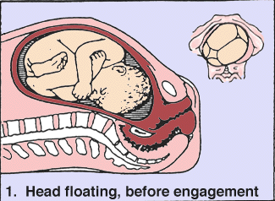
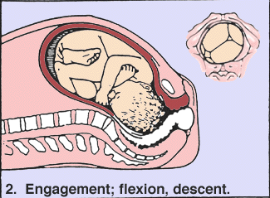
1. Engagement
The greatest diameter of the head has passed through the brim of the pelvis.

Slide 9
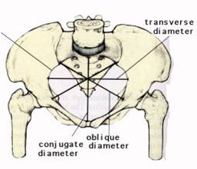
Diameters
1. Antero posterior diameter
2. Obstetric conjugate
3. Diagonal conjugate
4. Oblique diameter
5. Transverse diameter

Slide 10
How to find out Engagement ?
By P/A examination.
In clinical P/A examination foetal head is divided into 5parts.
If head is above pelvic brim it is not engaged. So 5/5th part of head lies above the brim.
In engaged head
- biparietal diameter enters the pelvic brim - tip of head lies at the level of ischial spine & - 1/5th of foetal head can be felt above the brim.

Slide 11
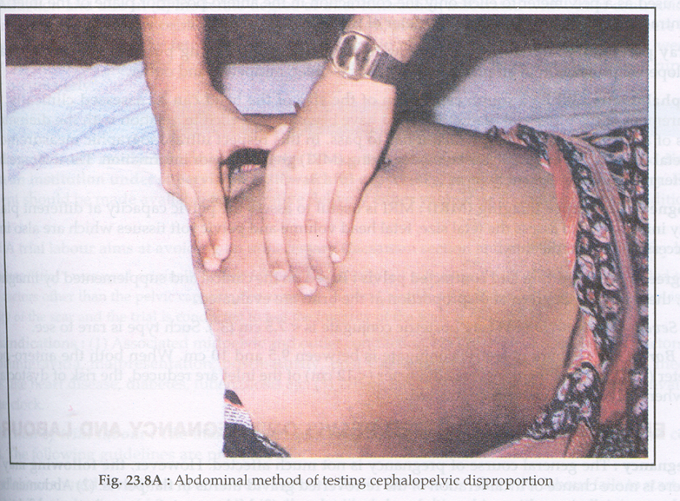

Slide 12
Engagement
In LOA of vertex
Denominator –
Occiput lies in relation to Lt ilio pectineal eminence in Lt anterior quadrent.
Sinciput locate towards Rt sacro ilial jt in Rt post quadrent.
Sagital sucture lies on Rt oblique diameter of maternal pelvis
In ROA of vertex
Occiput lying at Rt anterior quadrant.
So engagement of vertex occures in Lt oblique d.
Engaging diameters of foetal head is
Transverse diameter-
Biparietal – 9.4cm,3 3\4”
Antero posterior diameter-
Suboccipito bregmatic –
- 9.4cm,3 3/4”
So both the diameters are in the same plane.
{Oblique d measures from one sacro iliac Jt to opposite ilopectenial eminance 12cm,
4 3/4”}
LO
RO

Slide 13
Fixation
Fixation of the presenting part is that a portion of the presenting part is entering into the supirior strait .
So the surrounding structure and abdominal muscles help in fixing the presenting part .
In primi fixation and engagement occurs during last few weeks of pregnancy
In multi fixation and engagement occurs at the commencement of labor.

Slide 14
About 60 to 70% of the cases in early labour vertex engages at trasverse diameter of pelvic brim (synclitism)
i.e., left occiputo trasverse(LOT) or (ROT) usually a slight lateral inclination of foetal head occurs .
i.e., when sagittal suture lies near to the symphysis pubis or sacral promontry due to this lateral inclination it is called asynclitism or parietal obliquity .

Slide 15
Asynclitism is of 2 types
posterior asynclitism
or
posteior parietal obliquity
or
Litzman’s obliquity
anterior asynclitism
or
anterior parital presentation
or
naegele’s obliquity

Slide 16
In primi due to tight abdominal wall sagital suture lies nearer to symphysis pubis and so posterior parital bone becomes lower then anterior wall .so it becomes leading presenting part
So it is posterior asynclitism or posteior parietal obliquity or Litzman”s obliquity .
This asynclitism gets gradually corrected when the head desents
then the vertex rotates 2/8th circle on the pelvic floor as occiputo anterior postion.
If the sagital suture is near the sacral promontry – anterior parital presentation or anterior asynclitism or naegele”s obliquity.

Slide 17
Desent and flexion
Continuous desent of the fetal head occurs through out the mechanism till head is born
Resistance are meternal soft passage (lower utrine segment and pelvic floor) promots full flexion of fetal head

Slide 18
The decent is brought about by: -
-intra utrine fluid pressure
- contraction of abdominal
muscles
The flexion is produced by:-
- Resistance of lower utrine
segmants
- pelvic floor
if the head engages in a deflexed position this desents helps complete flexion of the head .

Slide 19
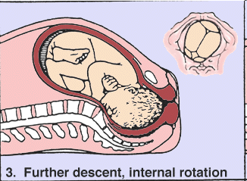
Internal rotation
It occurs on the pelvic floor .
So occiput rotates 1/8 th of a circule i.e., 45 degree towards midline to lie under pubic arch .
Then further desent occurs till occiput passes beyond simphysis pubis in flexed attitude of the fetal head .
So in LOA – occiput rotates 45 degree from right towards midline .
In ROA it rotates 45 from Rt towards midline.

Slide 20
Internal rotation occurs due to :-
-forward gutter like slope of the pelvic floor
- part of fetus meeting the resistance of one half of pelvic floor will be rotated
forward .
- unequal flexibility of the various parts
of the fetus.
when the internal rotation is completed , the occiput comes to lye underneath the symphysis pubis and head is in complete flexion

Slide 21
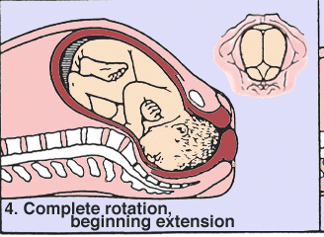
Extention
Extention of the fetal head occurs on the perineum beyond pelvic outlet .
Crowning occurs hear .
Streaching of the perinium
Vault forehead and face of foetal head are born over the edge of the perinium
Where as the subocciput stems under pubic arch and thus head is born

Slide 22
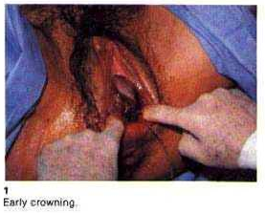
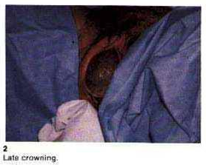

Slide 23
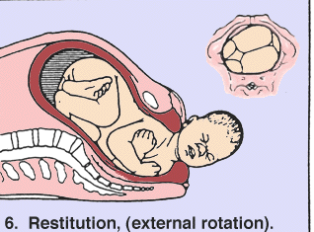
Restitution
After birth of the fetal head LOA
Occiput rotates 1/8 of a circule laterally towards left side to undue the twisted neck caused by internal rotation of head and chin rotates to right side .
so neck is untwisted in restitution
In ROA occiput rotates 1/8 th of a circule on right side and chin to left side .

Slide 24
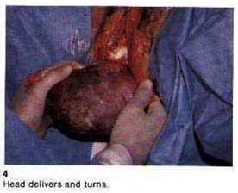

Slide 25
External rotation
The exposed free fetal head rotates again 1/8th circule following restitution till occiput lies 3 o clock position towards the respective thigh and face lies on the opposite side .
In LOA - occiput rotates towards left thigh in ROA - occiput rotates towards right thigh
This is due to the rotation of anterior shoulder on the pelvic floor

Slide 26
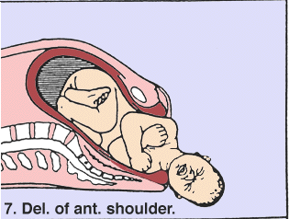
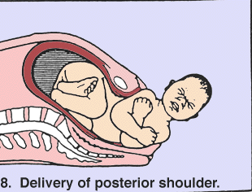
Lateral flexion
By this movement shoulders and trunk are born .
Anterior shoulder hitches under symphysis pubis
Then posterior shoulder born first by the lateral flexion followed by anterior shoulder.
Rest of the trunk is born by lateral flexion next

Slide 27
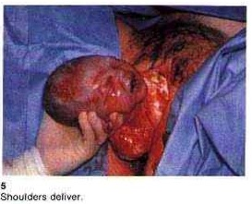
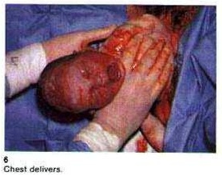

Slide 28
During the next stage the placenta and its membranes become seperated from the uterine wall and extruded p/v
After placental expulsion uterus contracts and retracts to become a cricket ball size
Then the bleeding stops completely

Slide 30
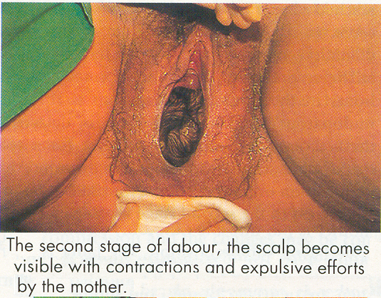

Slide 31
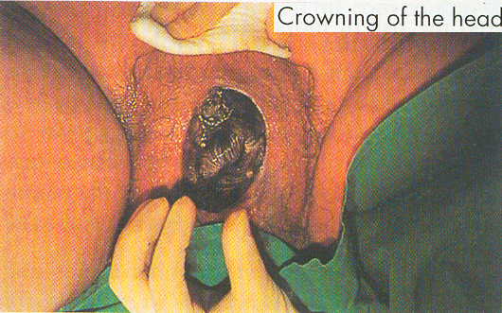

Slide 32
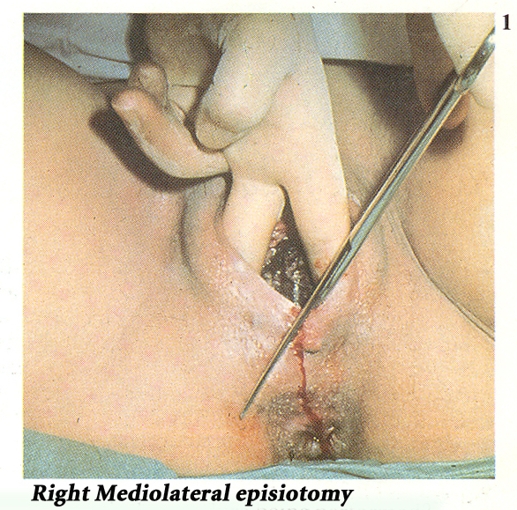

Slide 34
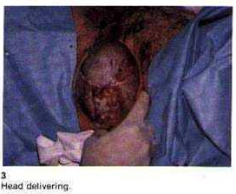

Slide 35
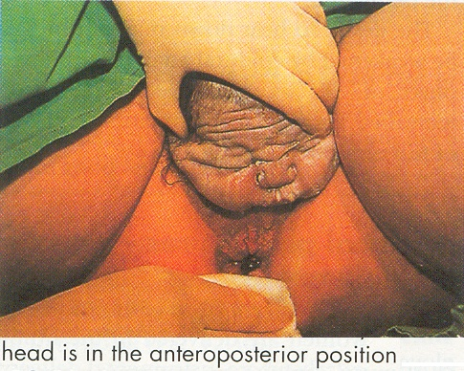

Slide 38
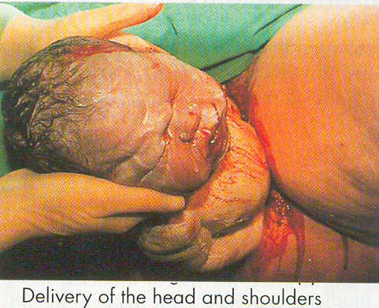

Slide 40
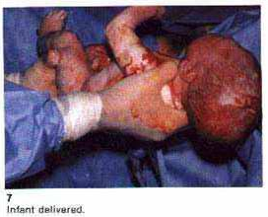

Slide 41
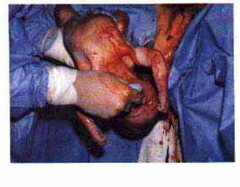

Slide 42
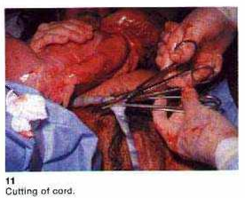

Slide 43
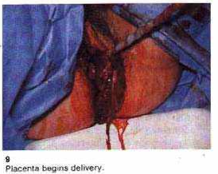

Slide 44
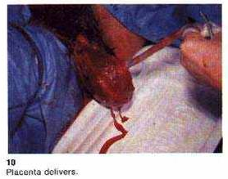

Slide 45
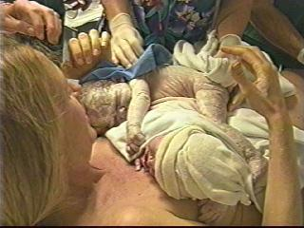

Slide 46
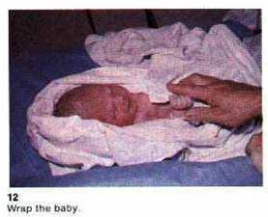

Slide 47



